Slide 1
The HathiTrust Research Center:
What’s in it for the UIUC Library?
Glen Worthey
Associate Director for Research Support Services

Slide 2
A personal introduction

Slide 3
HathiTrust
Overview
Formed in 2008 as a consortium of libraries
Initially, a collaboration among the CIC (Big Ten) universities and the U. of California system
… Illinois is a founding member (obviously)
Currently, 160 member libraries worldwide
Mainly, but not exclusively, in anglophone countries
Emergency Temporary Access Service (ETAS) response to COVID-19

Slide 4
HathiTrust Digital Library
Overview
Currently digitized (as of April 2020):
17,371,577 total volumes
8,395,344 book titles
469,301 serial titles
6,080,051,950 pages
779 terabytes
206 miles
14,114 tons
6,723,757 volumes(~39% of total) in the public domain

Slide 5
HathiTrust Research Center
Overview
Jointly established in 2012 by:
Indiana University
University of Illinois, Urbana-Champaign
HathiTrust
… in order to “facilitate non-profit and educational uses of HathiTrust (HT) and its Digital Library by enabling computational analysis of public domain works and (on limited terms) in-copyright works from its collection,” and to “advance the areas of text data mining, non-consumptive research and data literacy, allowing scholars to fully utilize HathiTrust content while preventing intellectual property misuse within the confines of current U.S. copyright law.”
Public presence: http://analytics.hathitrust.org

Slide 6
HathiTrust Research Center
Mission & activities
facilitate non-profit and educational uses of the HathiTrust Digital Library
computational analysis
text data mining
non-consumptive research
data literacy
Public presence: http://analytics.hathitrust.org

Slide 7
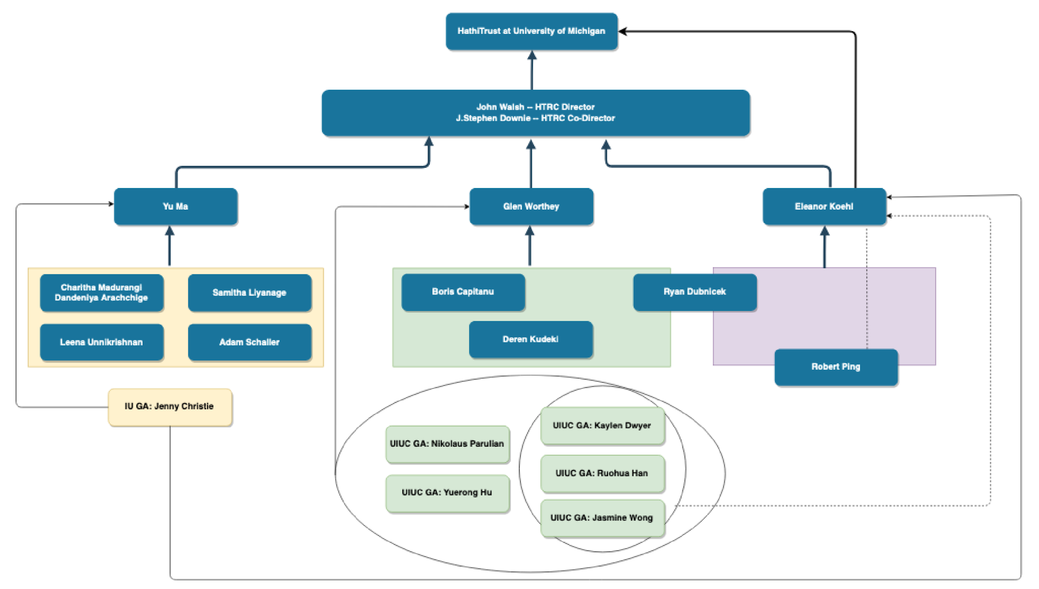

Slide 8
HTRC at Illinois:
Research Support Services
(essentially)

Slide 9
Illinois commitments to HTRC
(particularly Library commitments)
Memorandum of Understanding (and concomitant funding)
among the offices of the Vice Chancellor for Research, the Provost, the Library, and the iSchool for support from Jan. 2019-Dec. 2023 (“HTRC Phase 2”)
Advisory Committee:
Timothy Cole
Spencer Keralis
Ruby Mendenhall (Sociology / African American Studies)
Dan Tracy
Ted Underwood (English / iSchool)
Cheng Xiang Zhai (Computer Science / IGB)

Slide 10
HTRC Research Support Services
Mission:
Support and advance non-consumptive research access to the HathiTrust Digital Library and promote innovative uses of the collection to support new scholarship and deeper understanding of the cultural record.
Improve the productivity of the HTRC user community through successful, meaningful collaborations, including formal programs such as Advanced Collaborative Support, as well as on-demand services for workset creation for use by HT and affiliated researchers.
Steer the evolution of HTRC tools and services to improve the effectiveness of the HTRC cyberinfrastructure, based on community feedback.
Coordinate work on projects undertaken by HathiTrust staff or working groups, with a goal of improving HT services.

Slide 11
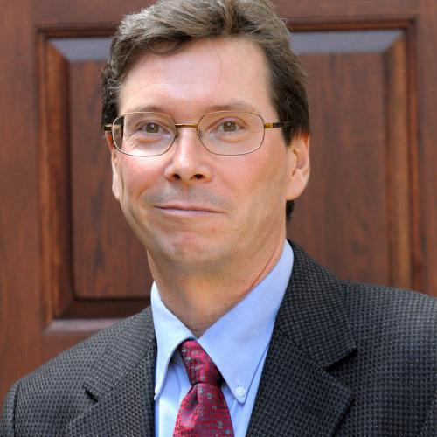
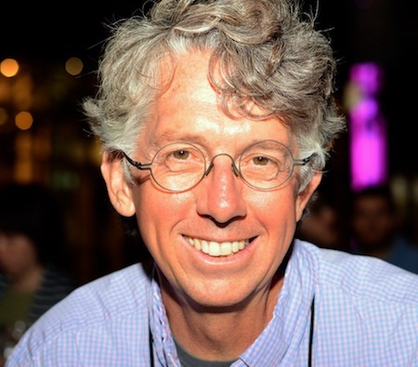
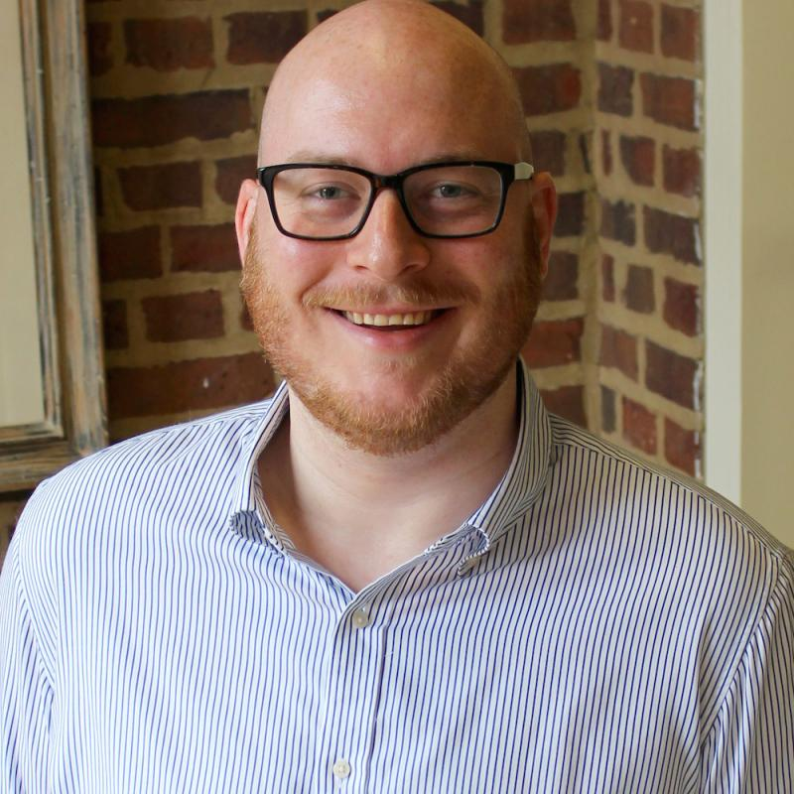
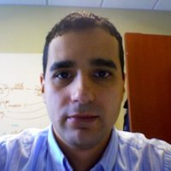
Research Support Services Personnel (1 of 3)
J. Stephen Downie, Co-Director, HTRC
Set the research agenda of RSS
Lead RSS and manage staff
Glen Worthey, Associate Director, RSS
With Downie, manage RSS day-to-day operations
Lead design and management of new HTRC services and tools, across units
Ryan Dubnicek, Digital Humanities Specialist
Project management, internal and external
User support and outreach, workshop instruction
Boris Capitanu, Senior Research Developer
Leads service and tool development and design
Technical DH/CA project support

Slide 12


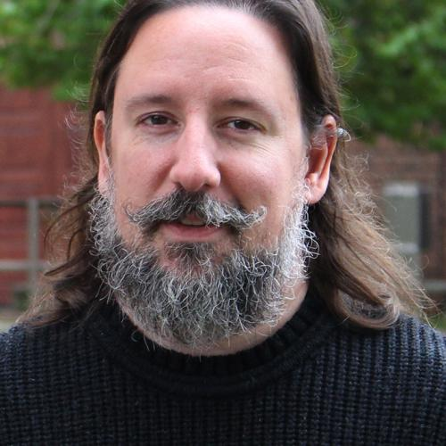
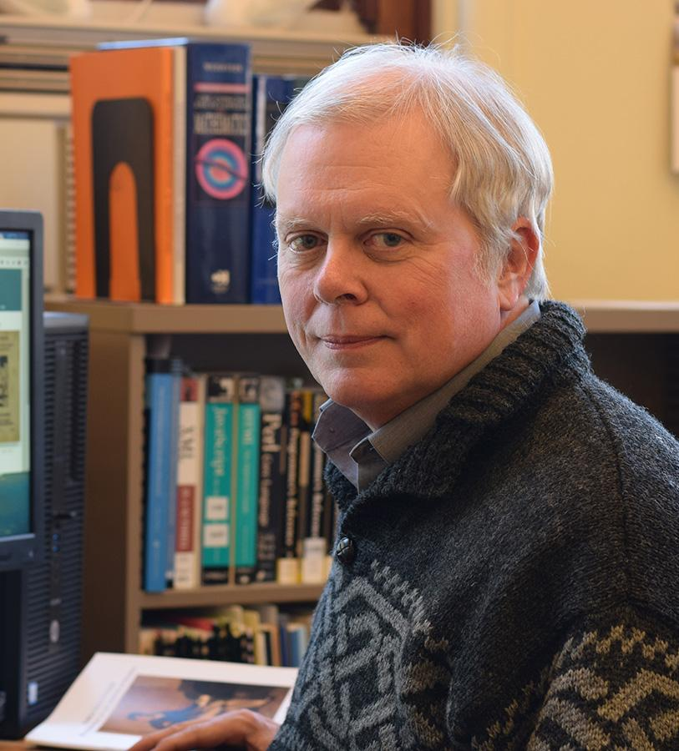
Research Support Services Personnel (2 of 3)
David Bainbridge, Developer (hourly)
Service and tool development, back-end and front-end
Data processing and management
Deren Kudeki, Visiting Research Programmer
Service and tool development (full stack)
Data processing and management
Metadata and linked data processing and implementation
Jacob Jett, Post-Doctoral Research Associate
Metadata ontology and schema design, linked data design
Timothy Cole, Professor, University Library
Information retrieval consultation
Linked data services consultation and design

Slide 13
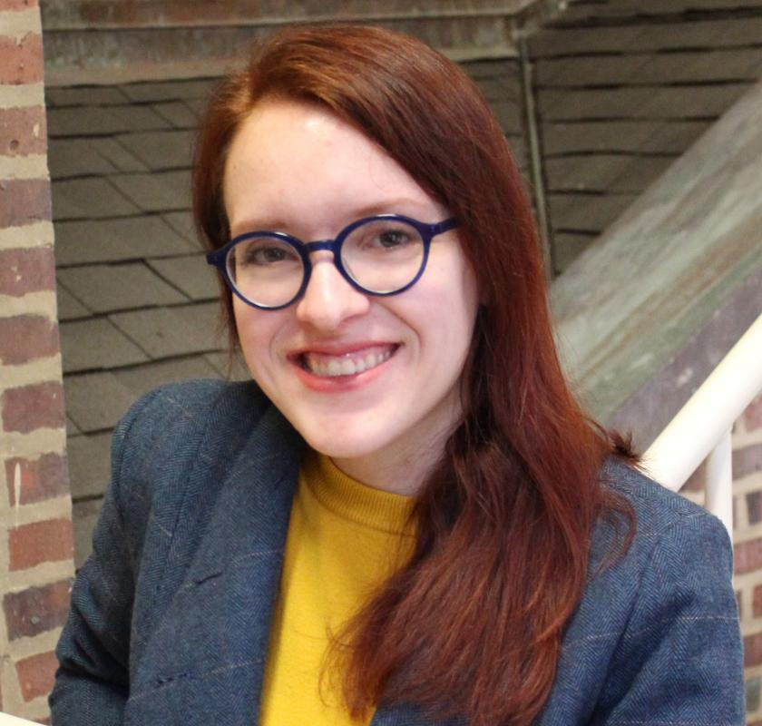
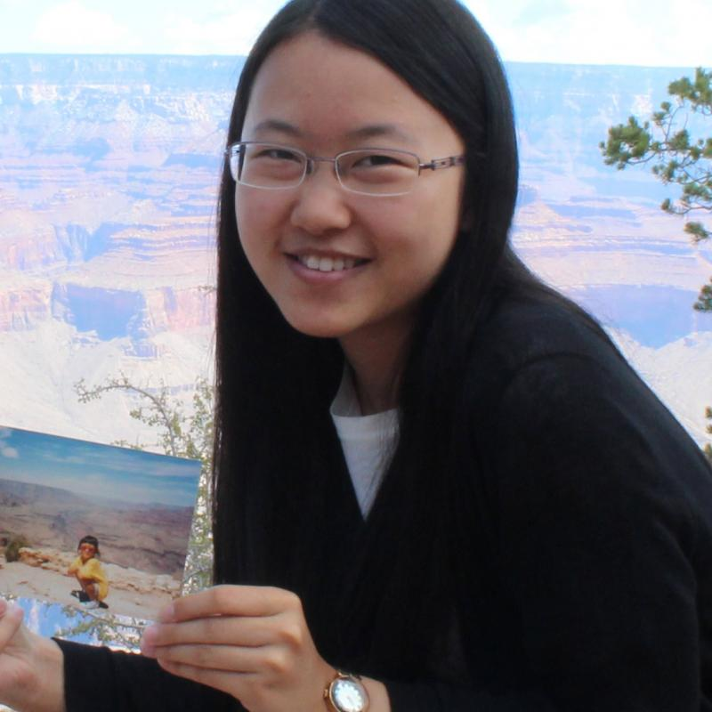
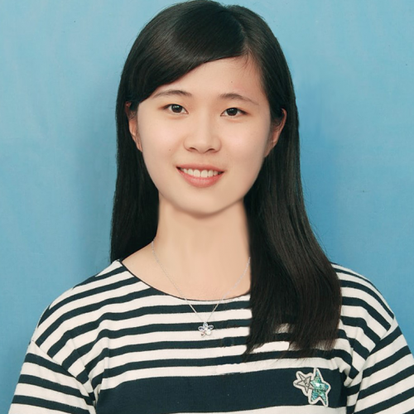

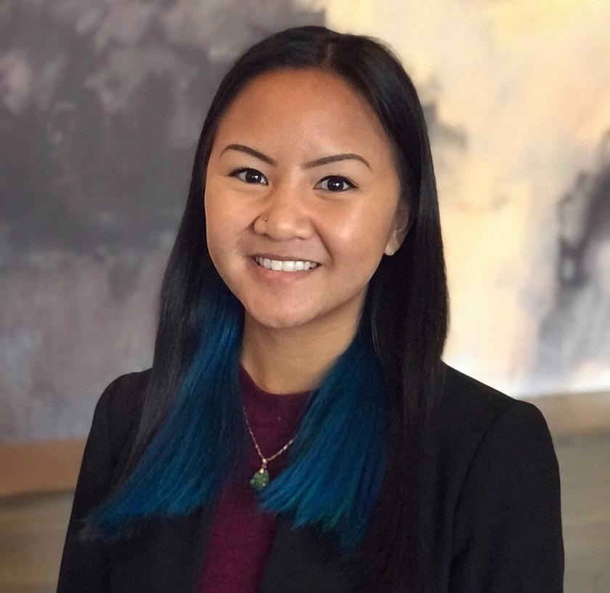
Research Support Services Personnel (3 of 3)
Research Assistants:
Kaylen Dwyer Ruohua Han Yuerong Hu Nikolaus Parulian Jasmine Wong
These RAs are often assigned to other units (particularly OES)
Duties include:
Software development and testing
Documentation, development of support and instructional materials
Publication and logistical support

Slide 14
HTRC Activities & Services
(particularly at Illinois)

Slide 15
HTRC Activities & Services
Keyword: non-consumptive research
or, non-expressive research

Slide 16
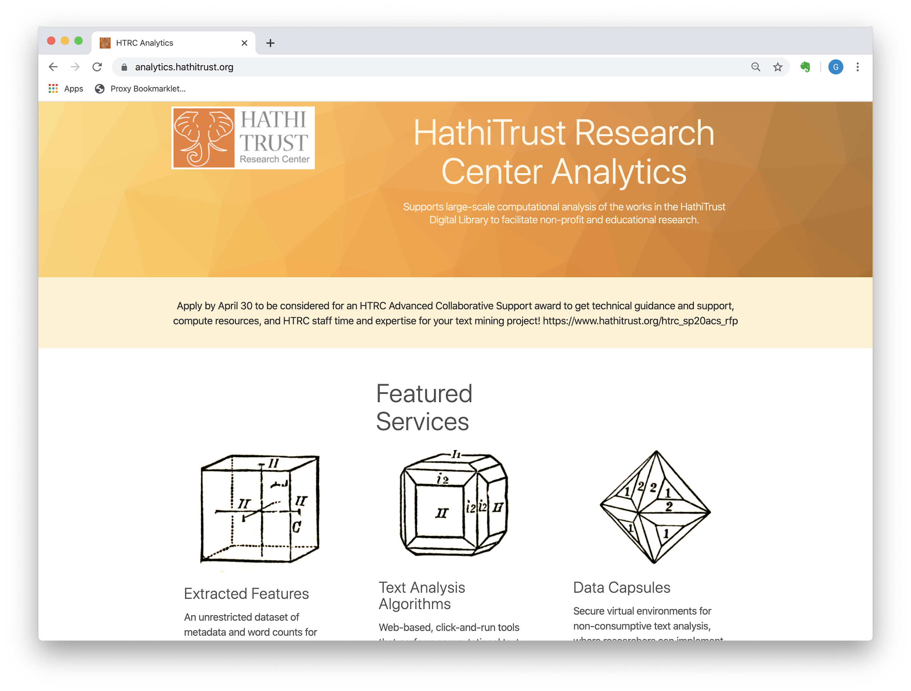

Slide 17
Extracted Features
Rich descriptive and statistical data…
...from all 17.2 million volumes currently in the HT Digital Library...
...including in-copyright volumes.
Volume-level metadata...
...expressed as Linked Data.
Page-level statistical information
word counts
part-of-speech counts
other useful fine-grained data
All of this is data about the book and its contents, rather than their expression

Slide 18
Web-based text analysis algorithms
Fairly rudimentary 1-gram viewer (like the Google n-gram viewer
Fairly rudimentary topic modeling
Named entity recognition
Token counts and very basic visualizations

Slide 19
Data capsules
An isolated, controlled computing environment…
… dedicated to a single research project
… with full access to content (including in-copyright)
… with a full suite of software
… and the ability to use one’s own software
… and tightly-controlled export protocols

Slide 20
Advanced Collaborative Support
In-kind commitments of research support (project management, programming, analysis, etc.)...
… made on a competitive basis
… to researchers from any HathiTrust member institution

Slide 21
Thanks, and let’s be in touch!
Glen Worthey
gworthey@illinois.edu
@gworthey

