Slide 1

ClimateQUAL at Illinois
Preliminary analysis
May 22, 2015

Slide 2
Agenda
Background
What ClimateQUAL measures (jargon decoded!)
Library-wide data
Illinois compared to other libraries
Next steps in the analysis and reporting
Questions

Slide 3
ClimateQUAL
ClimateQUAL©: Organizational Climate and Diversity Assessment is an assessment of library staff perceptions concerning (a) their library’s commitment to the principles of diversity, (b) organization policies and procedures, and (c) staff attitudes.
ClimateQUAL© aims to:
  Foster a culture of healthy organizational climate and diversity;
  Help libraries better understand staff perceptions of organizational climate and diversity;
  Facilitate the on-going collection and interpretation of staff feedback;
  Identify best practices in managing organizational climate; and
  Enable libraries to interpret and act on data.

Slide 4
Climate QUAL at UIUC Library
April 2014: Climate Survey Working Group appointed. Members, Cindy Ingold, Chair; Jim Cotter, Qiang Jin, Cindy Kelly, Sue Searing, Jen-Chien Yu
Fall 2014: Decided to do ClimateQUAL
Winter/Early Spring: Working group members met with divisions, units, and committees
Feb. 24-March 14: Survey administered
Early April: Report received from ARL
Early May: Report shared via LibNEWS
FAQ Page at http://www.library.illinois.edu/assessment/climatequal

Slide 5
Levels of Analysis
All ClimateQUAL libraries
University Library
Data subsets

Slide 6
What ClimateQUAL Measures
Organizational Climate (OC)
Organizational climate refers to the interpretative frameworks shared by employees regarding the priorities of their organization and it helps them understand what behavior is rewarded, supported, and expected in the organization. There are 9 organizational climate scales.
Organizational Attitudes (OA)
The information summarized in this section measures employee attitude on a number of different topics, such as their commitment to the organization, their satisfaction with their work, the extent to which they feel empowered. There are 7 measures for organizational attitude.
Detailed information on each of the scales can be found at http://www.climatequal.org/about/concepts/core-scales

Slide 7
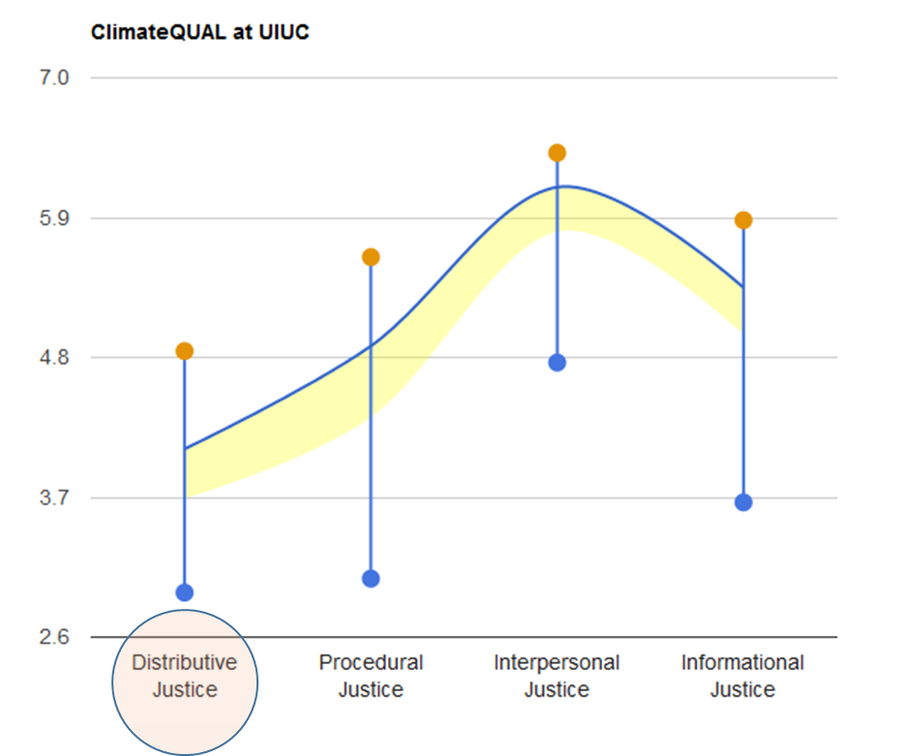
OC Scale 1: Organizational Climate for Justice
Distributive Justice reflects employees’ perceptions regarding the extent to which the rewards they receive (e.g., pay, opportunities to advance, etc.) are adequate given their level of effort and work.
Sample question: “Do the rewards in your division reflect the effort that division members put into their work”.
Best Score
UIUC
Peer
Average
Worst Score

Slide 8
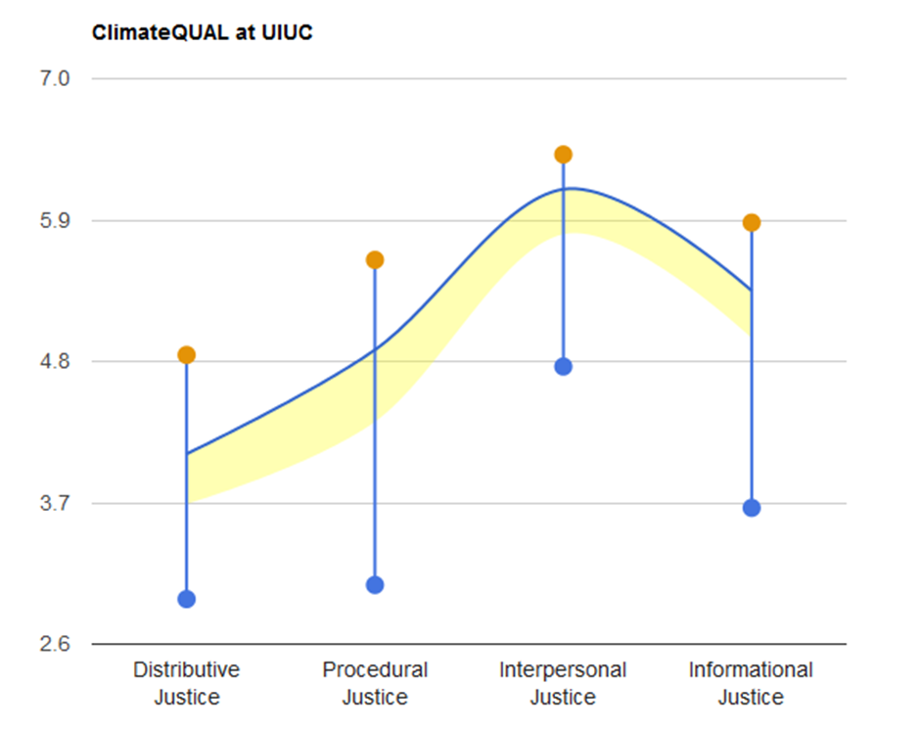
OC Scale 1: Organizational Climate for Justice
Procedural Justice addresses the fairness of procedures used to come to those outcomes (i.e. performance evaluations, amongst others).
Sample question: “Have the procedures used to determine rewards been applied consistently”.

Slide 9
OC Scale 1: Organizational Climate for Justice
Informational Justice refers to whether or not an employee has access to the information she needs.
Sample question: “Has the authority figure who determines rewards for your division explained procedures thoroughly.”.

Slide 10
OC Scale 1: Organizational Climate for Justice
Interpersonal Justice refers to the extent other people in the workplace, such as supervisors, treat an employee fairly.
Sample question: “Has the authority figure who determines rewards treated division members in a polite manner”.

Slide 11
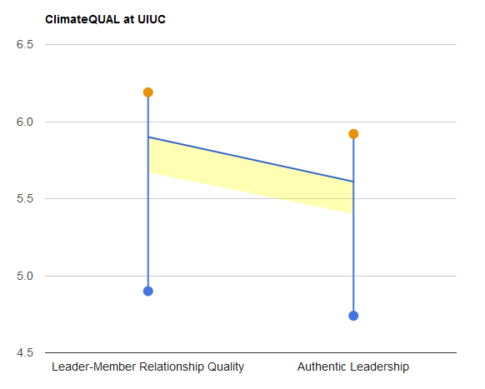
OC Scale 2: Climate for Leadership
Leader Member Relationship Quality refers to the quality of an individual’s relationship with their immediate supervisor.
Sample question: “I can count on my immediate supervisor to support me even when I’m in a tough situation at work”.

Slide 12
OC Scale 2: Climate for Leadership
Authentic transformational leader is ethical, honest, and inspiring.
Sample question: “My immediate supervisor is convincing when communicating his/her vision”.

Slide 13
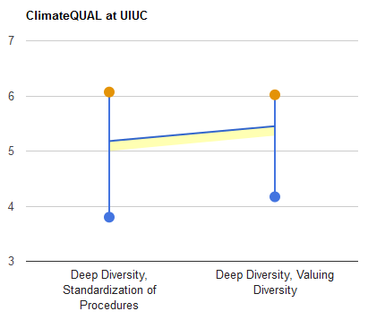
OC Scale 3: Climate for Deep Diversity
Standardization of Procedures Across Groups refers to the consistency of application of procedures across subgroups.
Sample question: “Performance reviews are based on objective criteria that minimize personal biases and prejudices”.

Slide 14
OC Scale 3: Climate for Deep Diversity
Valuing Diversity reflects the extent to which the organization values diversity and diversity-related initiatives.
Sample question: “This organization values the different perspectives that employees bring to the workplace”.

Slide 15
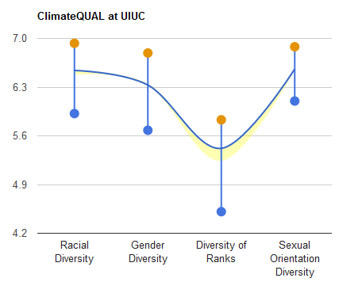
OC Scale 4: Climate for Demographic Diversity
Race refers to the extent to which the library supports racial diversity.
Sample question: “The race of a team/work unit member does NOT affect how they are valued on this team/work unit”.

Slide 16
OC Scale 4: Climate for Demographic Diversity
Gender reflects the extent to which an individual team supports diversity of genders.
Sample question: “The gender of a team/work unit member does NOT affect how they are valued on this team/work unit”.

Slide 17
OC Scale 4: Climate for Demographic Diversity
Rank reflects whether the library has a climate that supports diversity among employees of different rank.
Sample question: “The rank of a team/work unit member does NOT affect how they are valued on this team/work unit”.

Slide 18
OC Scale 4: Climate for Demographic Diversity
Sexual Orientation assesses the extent to which the library has a climate supportive of sexual-orientation related diversity.
Sample question: “The sexual orientation of a team/work unit member does NOT affect how they are valued on this team/work unit”.

Slide 19
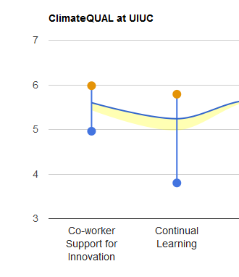
OC Scale 5: Climate for Innovation: Co-workers
Refers to the extent to which co-workers encourage each other to share and come up with innovative solutions.
Sample question: “Coworkers tell each other about other new information that can be used to increase job performance”.

Slide 20
OC Scale 6: Climate for Continual Learning
An organization with a Climate for Continual Learning has policies, practices, and procedures that emphasize continued employee education.
Sample question: “There is excellent on-the-job training”.

Slide 21
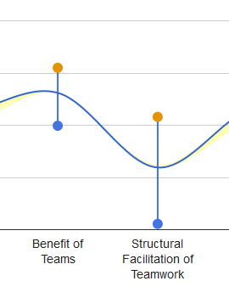
OC Scale 7: Climate for Teamwork
Employee Belief in Benefits of Teamwork concerns employees’ opinions of the usefulness and importance of teamwork.
Sample question: “Teamwork is important to completing work in this organization”.

Slide 22
OC Scale 7: Climate for Teamwork
Structural Facilitation of Teamwork refers to the degree to which the organization’s structure and policies facilitate and encourage teamwork.
Sample question: “The structure of this organization helps facilitate teamwork”.

Slide 23
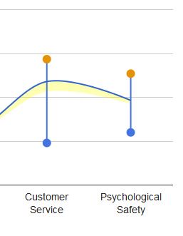
OC Scale 8 : Climate for Customer Service
The organization enacts policies, practices, and procedures that clearly indicate the importance and value of customer service.
Sample question: “Library employees have the job knowledge and skills required to deliver superior quality work and service”.

Slide 24
OC Scale 9 : Climate for Psychological Safety
Refers to the degree to which an organization or teams therein encourage employees to freely share opinions with each other and with management.
Sample question: “As an employee in this library one is able to bring up problems and tough issues”.

Slide 25
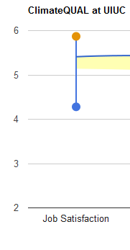
OA Scale 1 : Job Satisfaction
1 = Least Satisfied
7 = Most Satisfied

Slide 26
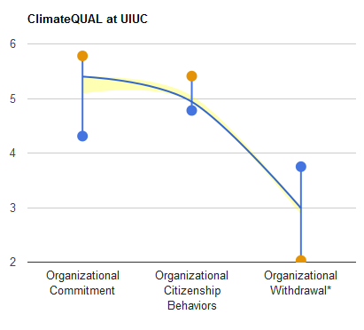
OA Scale 2: Organizational Commitment
Organizational Commitment refers to the extent to which an individual employee is dedicated to staying with, and feels positively about, this organization.
Sample question: “I am willing to put in a great deal of effort beyond that normally expected in order to help this organization be successful”.

Slide 27
OA Scale 3: Organizational Citizenship Behaviors
Organizational Citizenship Behavior (OCB) is an activity not included in an employee’s job description that they nonetheless conduct to improve the organization.
Sample question: “Give up time to help others who have work or non-work problems”.

Slide 28
OA Scale 4: Organizational Withdrawal* (lower score is better)
Organizational Withdrawal refers to the actions that an employee may engage in that distance themselves from the organization and reflect intentions to leave the organization.
Sample question: “How often do you explore other job opportunities by checking job listings or want ads”.

Slide 29
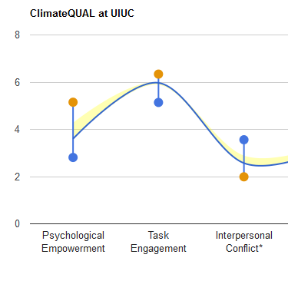
OA Scale 5: Team Psychological Empowerment
Team Psychological Empowerment in the workplace reflects the extent to which an individual feels they can contribute to their team.
Sample question: “People in my position can have a large impact on what happens in this Library”.

Slide 30
OA Scale 6: Task Engagement
Task engagement refers to the extent to which an employee is interested in and engaged in his/her work.
Sample question: “The work I do is very important to me”.

Slide 31
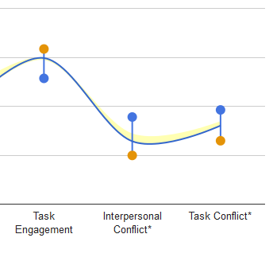
OA Scale 7: Work Unit Conflict*
(Lower score is better)
Interpersonal Conflict refers to the amount of personal or emotional conflict amongst a work unit.
Sample question: “How much jealousy or rivalry is there among members of your unit”.

Slide 32
OA Scale 7: Work Unit Conflict*
(Lower score is better)
Task Conflict refers to the disagreements coworkers have over how to complete their tasks.
Sample question: “How often do the members of your unit disagree about which procedure should be used to do your work”.

Slide 33
Themes from Comments
88 valid comments analyzed using ATLAS.ti
Selected Major Themes
  Survey Issues (21 observations)
  Co-worker Support (15 observations)
  Communication (15 observations)
  Supervisor (12 observations)
  Diversity (11 observations)
  Leadership (11 observations)
  Job Satisfaction (24 observations)

Slide 34
Other ClimateQUAL® Participants
University of Maryland
University of Florida
MIT
University of California, Berkeley
Texas A&M
University of Michigan
….. See the full list of participants at http://climatequal.org/about/partners

