Slide 1
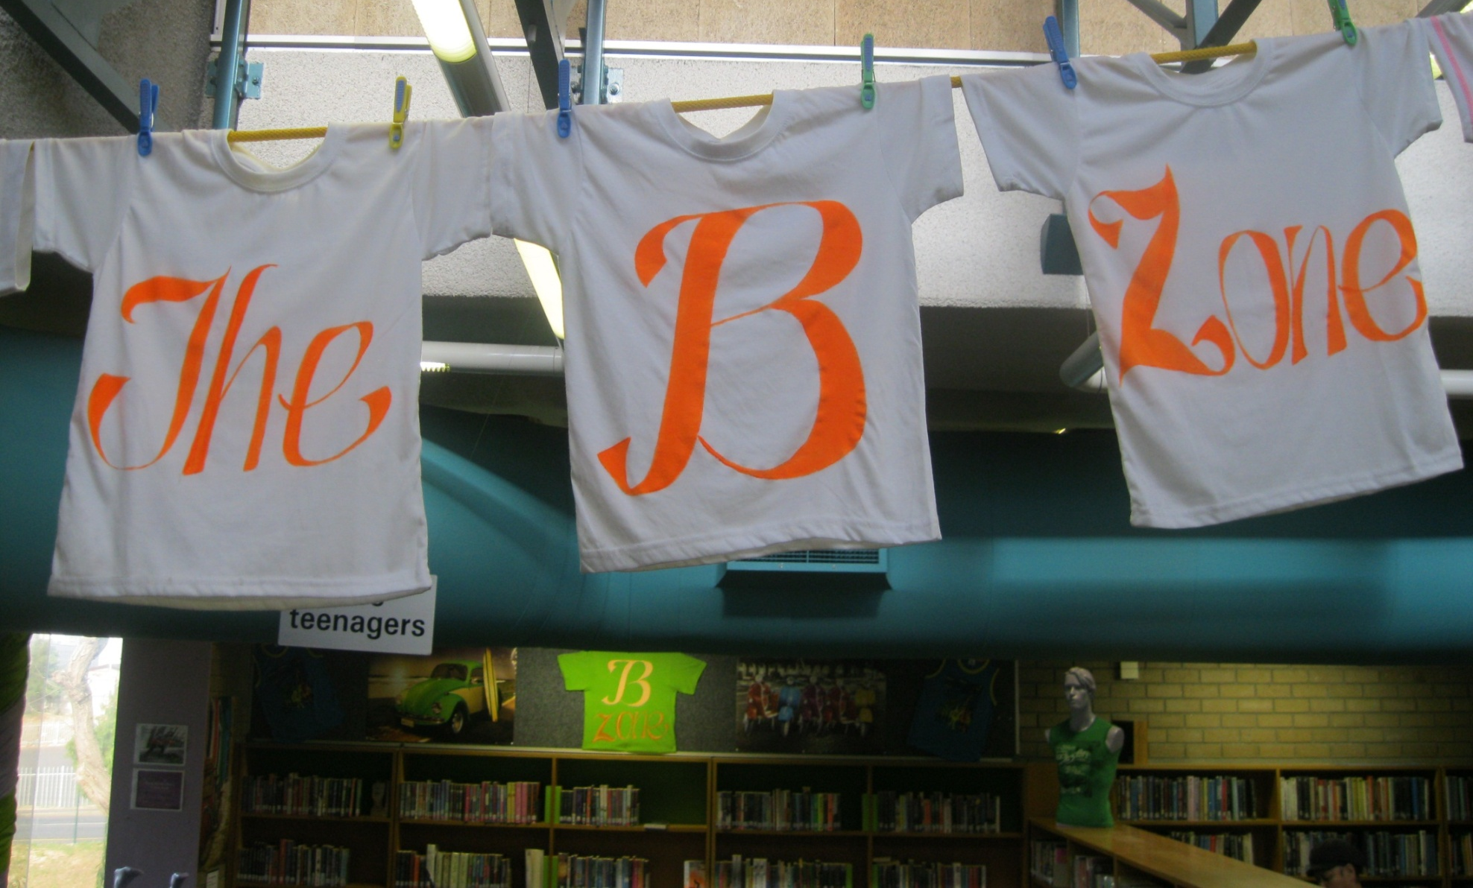
How it all started…..

Slide 2
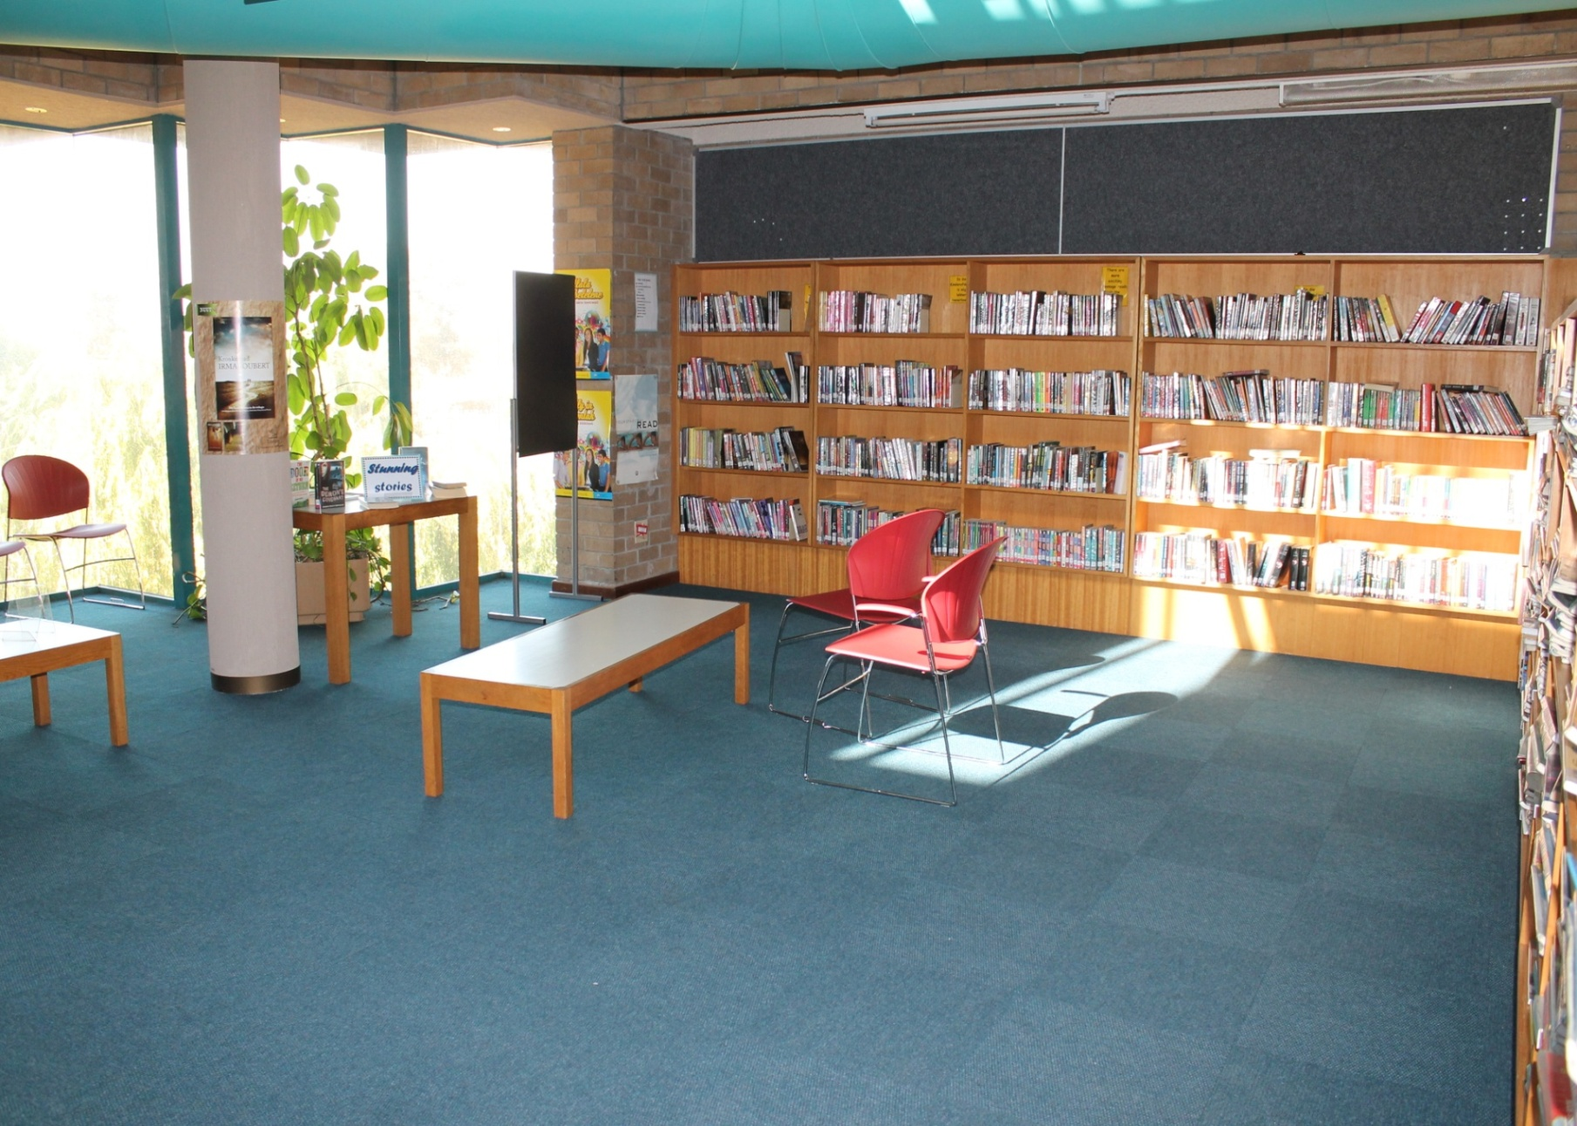
The Space!
Often misused by Non-teens
Only books available in section
Books sorted in genres
No colour
No Teens in sight

Slide 3
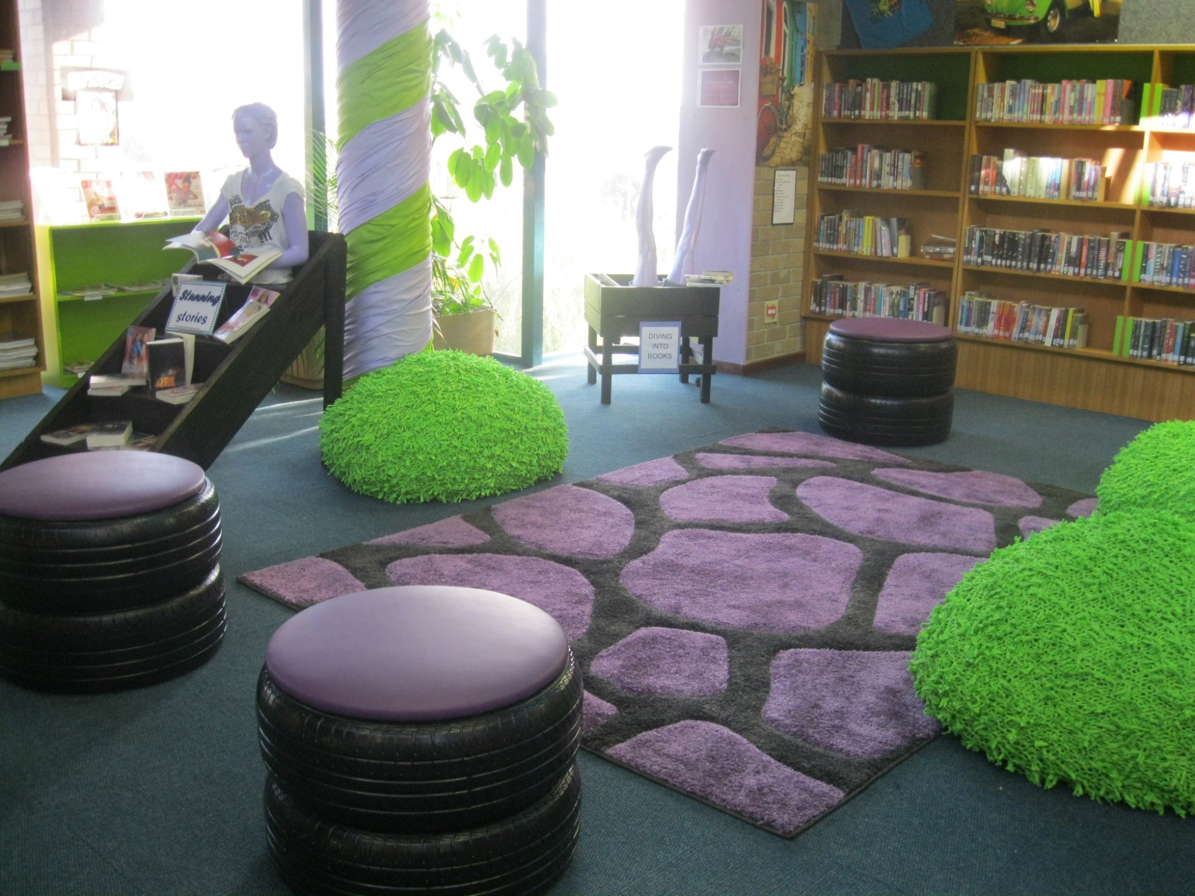
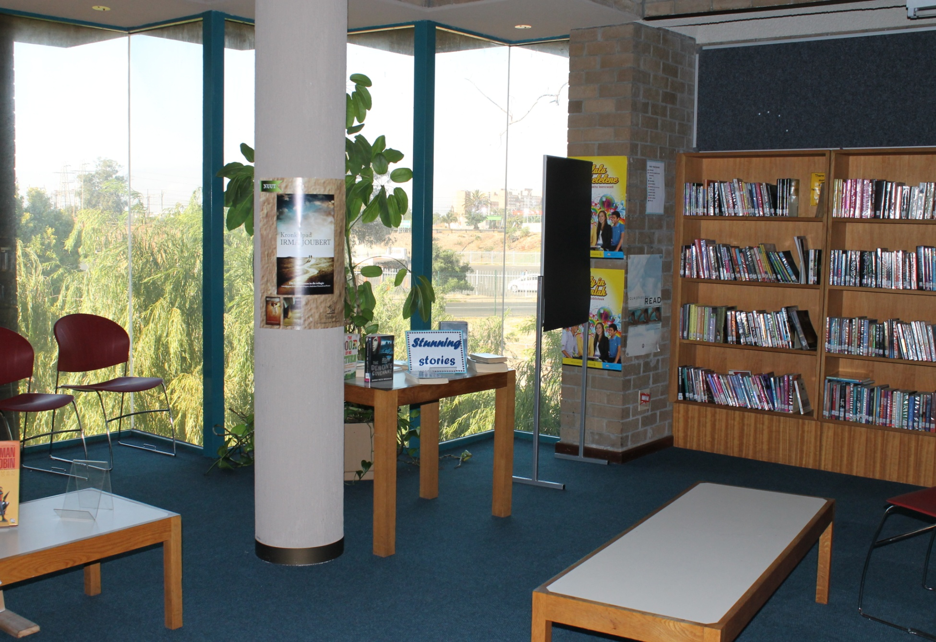
Before
After

Slide 4
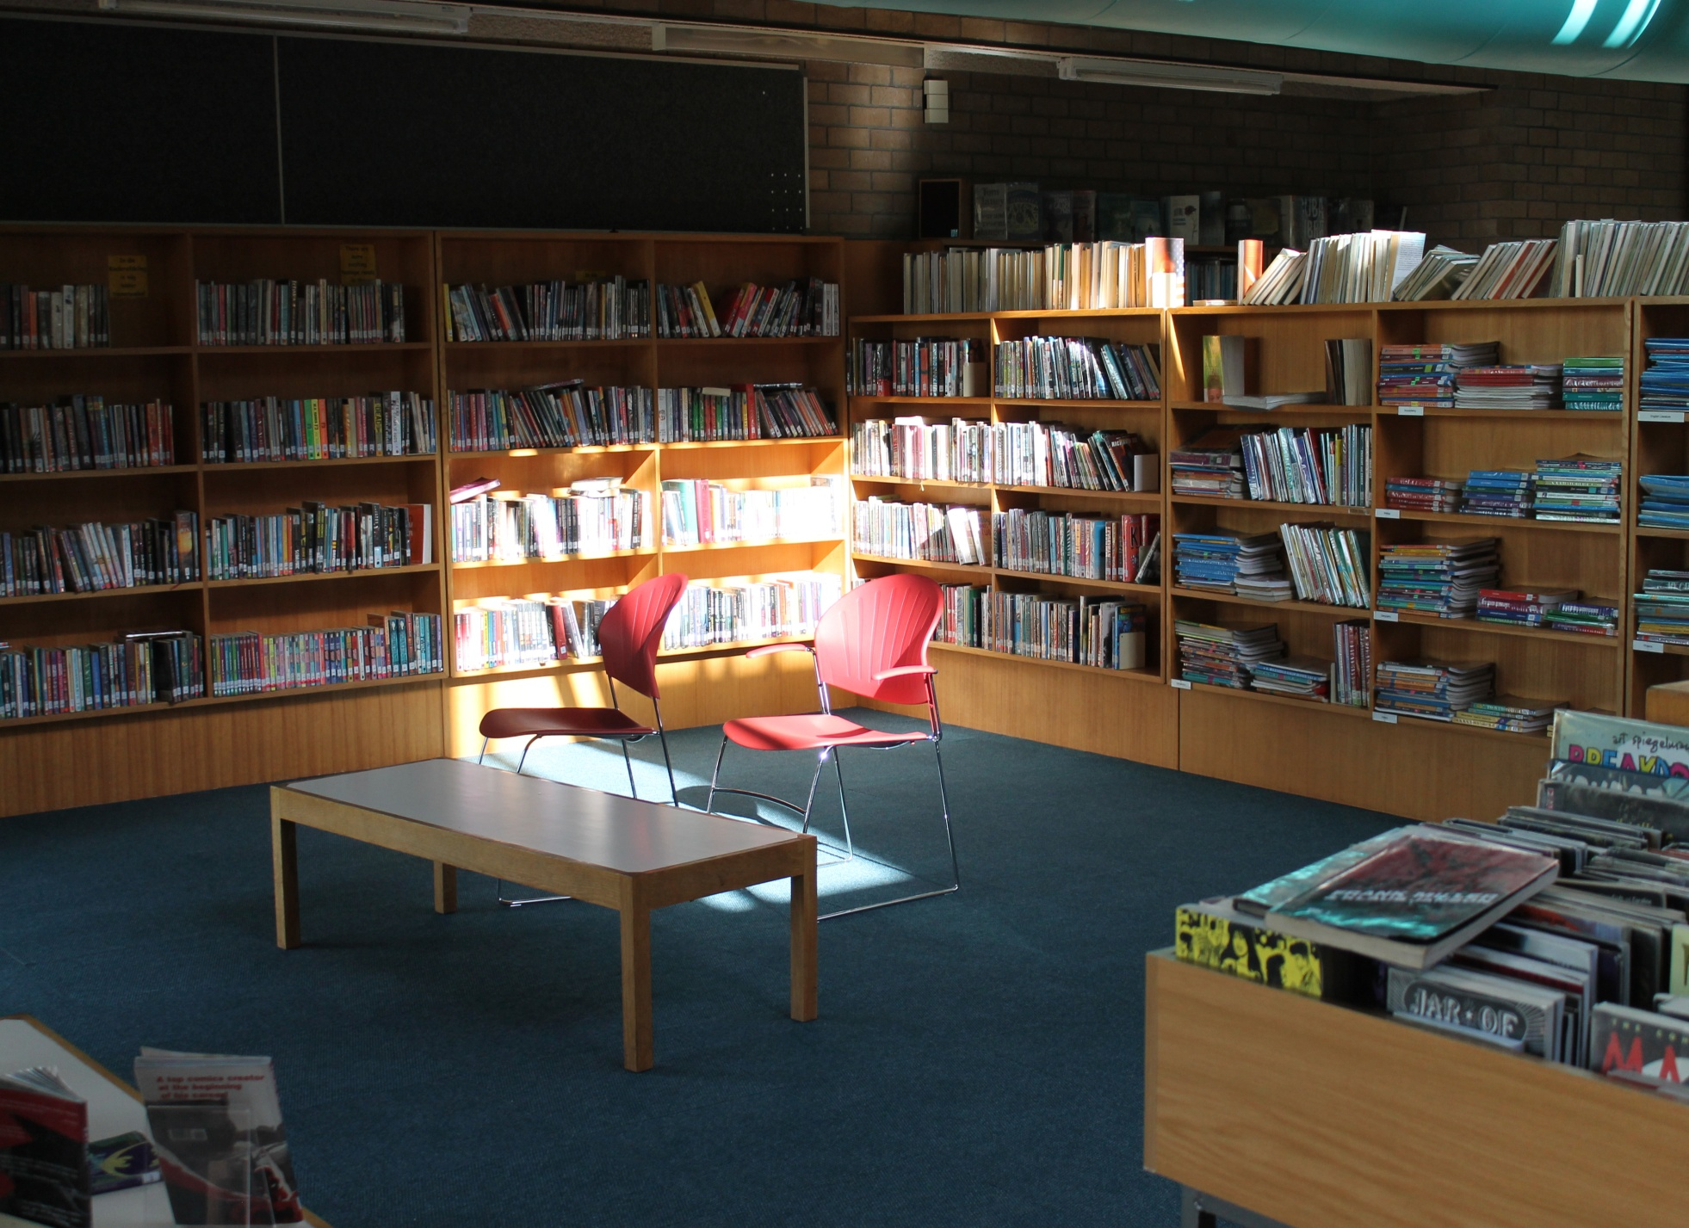
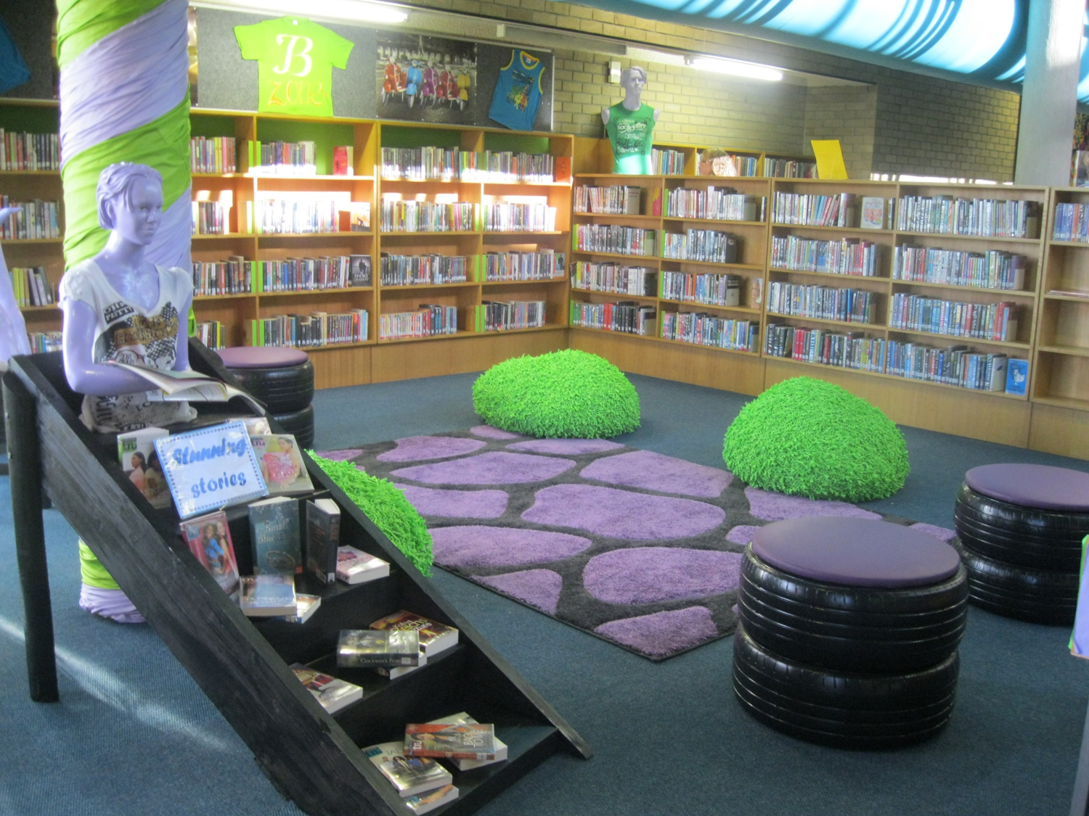
Before
After

Slide 5
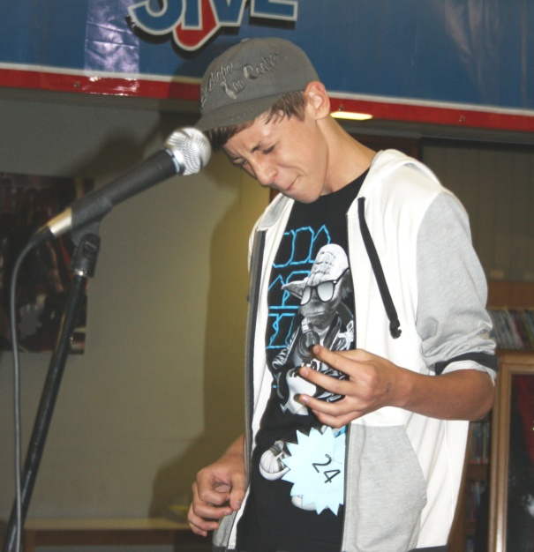
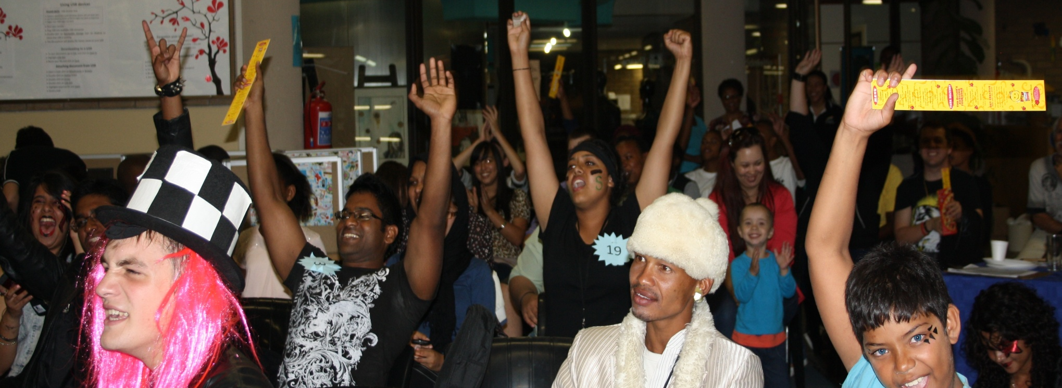
Launch
Air guitar competition:
+ 100 attendees
35 contestants
Prizes to the value of R40 000
Sponsorships and networking
Priceless: Cool library for teens!

